Slide 1

6th Grade Accelerated Math
Unit 4, Lesson 2 Points on the Coordinate Plane – Part 1 Volume 1, pg. 138

Slide 2


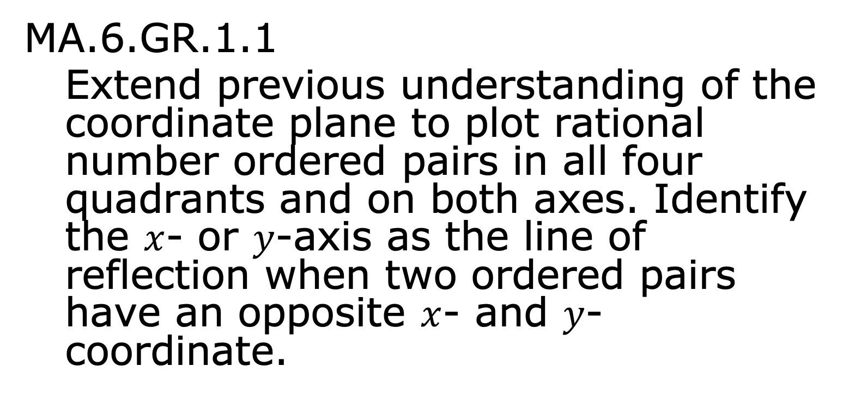
Benchmark
MA.6.GR.1.1
Extend previous understanding of the coordinate plane to plot rational number ordered pairs in all four quadrants and on both axes. Identify the $x$- or $y$-axis as the line of reflection when two ordered pairs have an opposite $x$- and $y$- coordinate.
volume 1, pg. 138

Slide 3
Integrated Mathematical Thinking and Reasoning Standards
MA.K12.MTR.1.1 Actively participate in effortful learning both individually and collectively.
MA.K12.MTR.4.1 Engage in discussions that reflect on the mathematical thinking of self and others.
MA.K12.MTR.5.1 Use patterns and structure to help understand and connect mathematical concepts.
MA.K12.MTR.6.1 Assess the reasonableness of solutions.
MA.K12.MTR.7.1 Apply mathematics to real-world contexts.
volume 1, pg. 138

Slide 4

Learning Targets
I can plot integers using different scales.
I can plot rational numbers in the form of decimal and fractional ordered pairs.
I can select an appropriate scale given a set of ordered pairs.
volume 1, pg. 138

Slide 5

Warm-Up
volume 1, pg. 138

Slide 6
4.2.1 Warm-Up: Interior Designer
After getting a degree in graphic design, Soledad Alzaga built her career and company as an interior designer. Interior designers make interior spaces functional, safe, and beautiful by determining space requirements and selecting decorative items such as colors, lighting, and materials. Beyond being creative and having good taste, Soledad says to own a successful interior design business, it is necessary to have the ability to work and communicate with others, be organized, have business knowledge, and to have math and measurement skills.
What is something that interests you that you would like to spend your career doing?
What skills do you think are needed to be successful in that career?
volume 1, pg. 138

Slide 7

Refresher
volume 1, pg. 139

Slide 8



4.2.2 Refresher: Key Terms with the Coordinate Plane
Several key terms related to the coordinate plane were used throughout Lesson 1. Below, you can find definitions for each of these key terms.
The coordinate plane is a plane determined by two perpendicular number lines, called axes. The axes intersect at the origin. Each point in the coordinate plane is represented by a pair of coordinates that represent the direction and distance from each axis. The origin is represented by the coordinate pair, $(0, 0)$.
volume 1, pg. 139

Slide 9

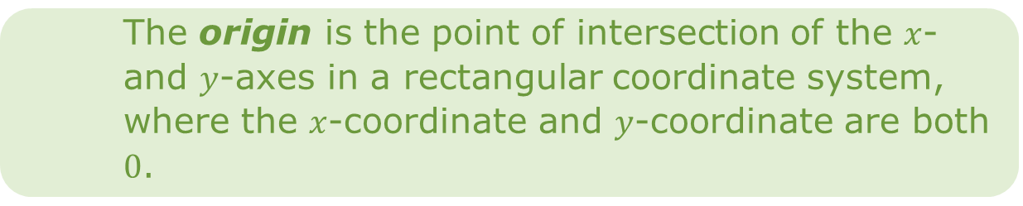
The axes of a graph are the horizontal and vertical number lines used in a coordinate plane system.
A coordinate is a number used to locate a point on a number line. A coordinate is one of the numbers in an ordered pair that locates a point on a coordinate plane.
The origin is the point of intersection of the $x$- and $y$-axes in a rectangular coordinate system, where the $x$-coordinate and $y$-coordinate are both $0$.
A quadrant is any of the four regions separated by the axes in a coordinate plane.
volume 1, pg. 139

Slide 10

Guided Instruction
volume 1, pg. 139

Slide 11
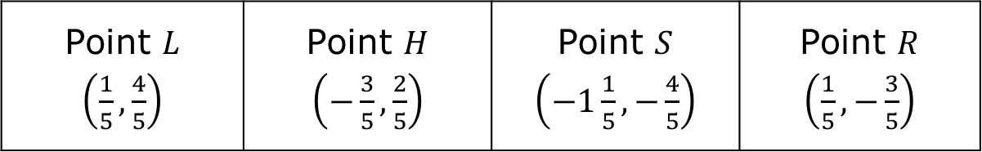
4.2.3 Guided Instruction: Plotting Points with a Fractional Scale
Four points are shown.
Based on the denominators of each fraction, what scale should be used for the grid?
Point $L$ $\left(\frac{1}{5}, \frac{4}{5}\right)$ | Point $H$ $\left(−\frac{3}{5}, \frac{2}{5}\right)$ | Point $S$ $\left(−1\frac{1}{5}, −\frac{4}{5}\right)$ | Point $R$ $\left(\frac{1}{5}, −\frac{3}{5}\right)$
volume 1, pg. 139

Slide 12
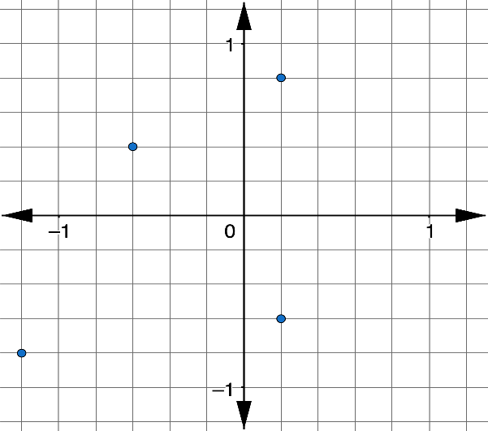
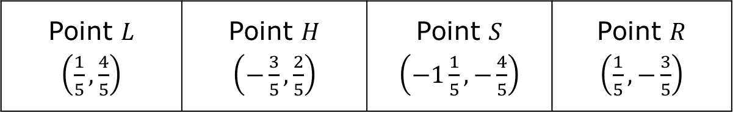
Find and label the points with the given letters on the coordinate plane.
Point $L$ $\left(\frac{1}{5}, \frac{4}{5}\right)$ | Point $H$ $\left(−\frac{3}{5}, \frac{2}{5}\right)$ | Point $S$ $\left(−1\frac{1}{5}, −\frac{4}{5}\right)$ | Point $R$ $\left(\frac{1}{5}, −\frac{3}{5}\right)$
volume 1, pg. 139

Slide 13
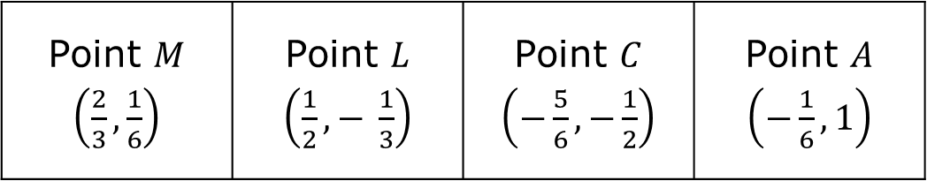
Another set of four points is shown.
List the denominators of each fraction.
Point $M$ $\left(\frac{2}{3}, \frac{1}{6}\right)$ | Point $L$ $\left(\frac{1}{2},− \frac{1}{3}\right)$ | Point $C$ $\left(−\frac{5}{6}, −\frac{1}{2}\right)$ | Point $A$ $\left(−\frac{1}{6}, 1\right)$
volume 1, pg. 140

Slide 14
Zoe says she does not want to label her axes by halves because she will only be able to approximate the location of the thirds. She also says she does not want to label by thirds because there is no easy way to approximate the location of the halves. Christopher says she should label her axes by sixths.
Explain the benefit of using Christopher’s plan.
volume 1, pg. 140

Slide 15
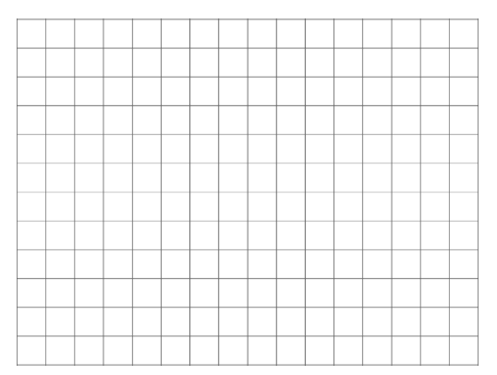
Draw and label coordinate axes with the scale you chose and plot the points.
volume 1, pg. 140

Slide 16

When deciding on a scale for plotting ordered pairs with rational values, consider the least common multiple (LCM) of each of the denominators to determine the proper increments.
volume 1, pg. 140

Slide 17

Collaboration
volume 1, pg. 141

Slide 18

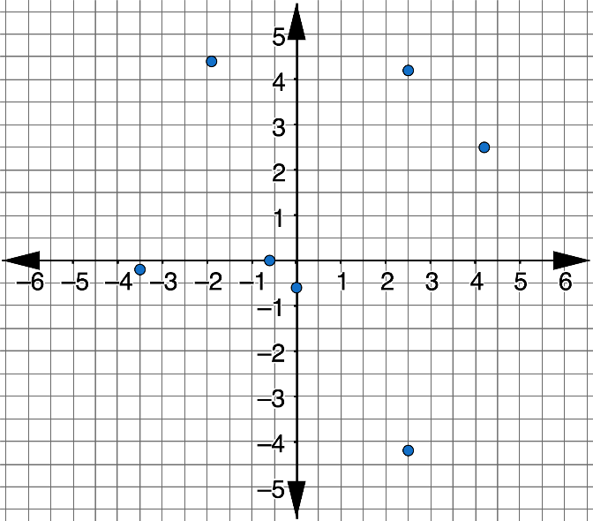
4.2.4 Collaboration: Plotting Points with a Decimal Scale
A coordinate plane is shown.
Working with your partner, describe the scale that is being used for each axis.
volume 1, pg. 141

Slide 19
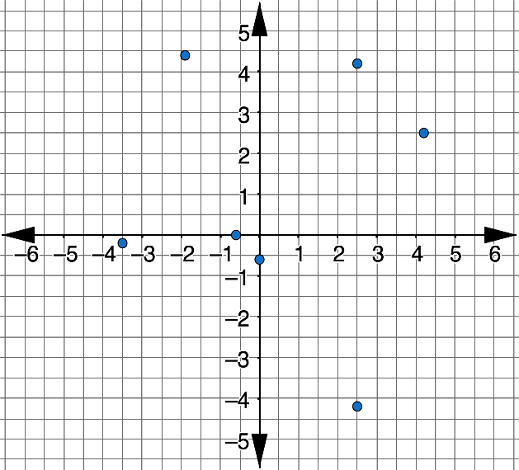
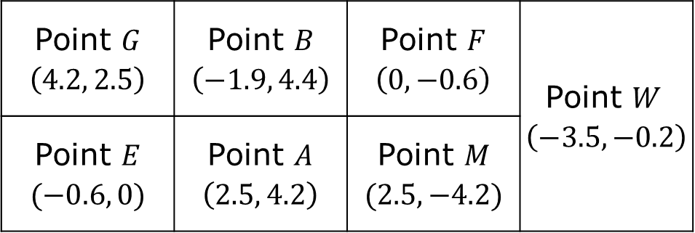
Locate each point on the coordinate plane and label it with the appropriate letter.
Point $G$ $\left(4.2, 2.5\right)$ | Point $B$ $\left(−1.9, 4.4\right)$ | Point $F$ $\left(0, −0.6\right)$ | Point $W$ $\left(−3.5, −0.2\right)$
Point $E$ $(−0.6, 0)$ | Point $A$ $\left(2.5, 4.2\right)$ | Point $M$ $(2.5, −4.2)$
volume 1, pg. 141

Slide 20
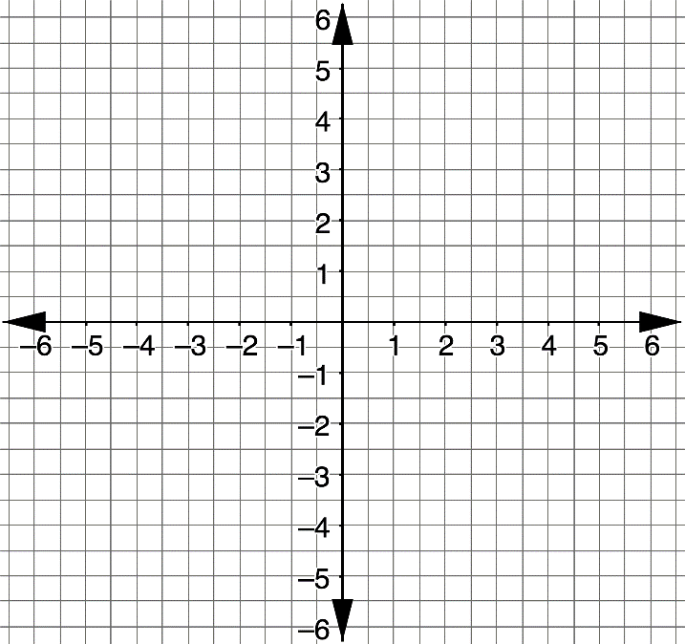
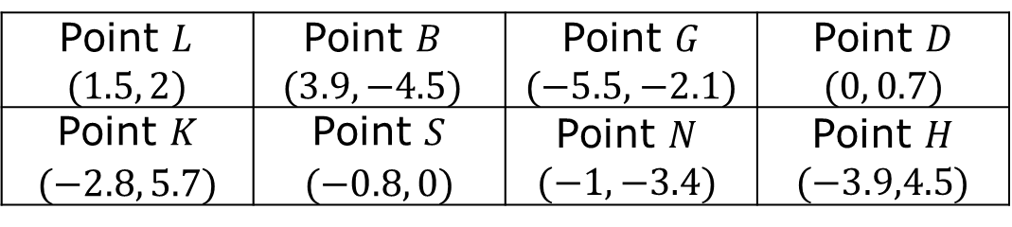
Working with your partner, plot and label the points using the given letters on the grid.
Point $L$ $$(1.5, 2)$$ | Point $B$ $$(3.9, −4.5)$$ | Point $G$ ($−5.5,$ $−2.1)$ | Point $D$ $$(0, 0.7)$$
Point $K$ $(−2.8, 5.7)$ | Point $S$ $(−0.8, 0)$ | Point $N$ $$(−1, −3.4)$$ | Point $H$ ($−3.9,4.5$)
Which points were easy to plot?
Which points were more difficult to plot?
volume 1, pg. 141

Slide 21
On your own, answer the following question:
When plotting ordered pairs with decimal values, how is it best to determine the scale to use when setting up the axes on a grid?
My Reasoning
volume 1, pg. 142

Slide 22
Share your reasoning with your partner and ask for feedback on any parts that were unclear or missing. Make any necessary edits to your reasoning.
volume 1, pg. 142

Slide 23
Collaboration
volume 1, pg. 142

Slide 24
4.2.5 Collaboration: Choosing the Right Scale
When representing data, the scale of the grid is important to effectively and accurately communicate information.
The table shows the total Florida tourism industry employees, in thousands, for years since 2002.
Years Since 2002 | Total Tourism Industry Employees (in thousands)
1 | 889.9
4 | 909.7
5 | 916.3
7 | 929.5
volume 1, pg. 142

Slide 25
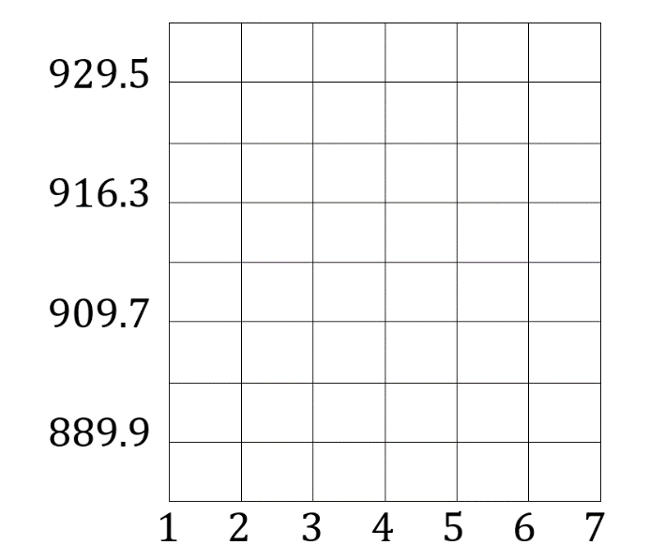
To plot the data, Andrea drew the coordinate grid shown.
Discuss with your partner why Andrea’s coordinate grid would not effectively nor accurately communicate the information about Florida tourism industry employees.
volume 1, pg. 142

Slide 26
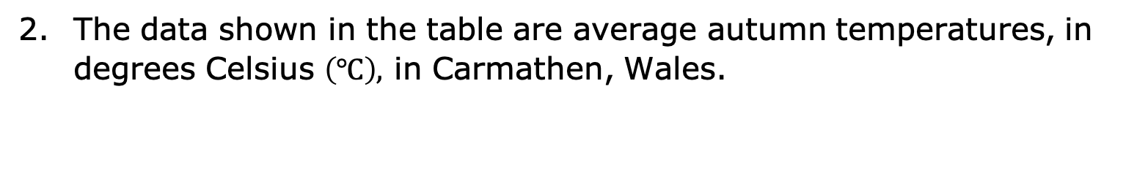
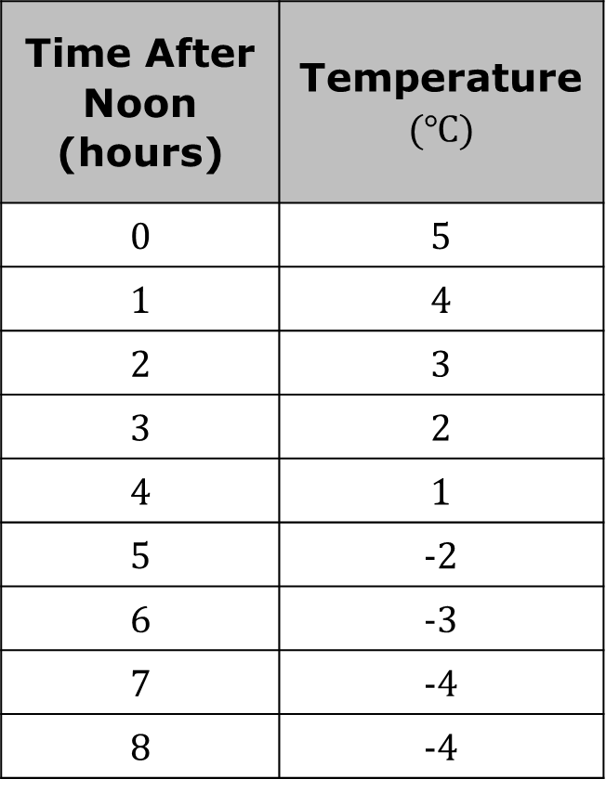
The data shown in the table are average autumn temperatures, in degrees Celsius $\left(℃\right),$ in Carmathen, Wales.
Time After Noon (hours) | Temperature $(℃)$
0 | 5
1 | 4
2 | 3
3 | 2
4 | 1
5 | -2
6 | -3
7 | -4
8 | -4
volume 1, pg. 143

Slide 27
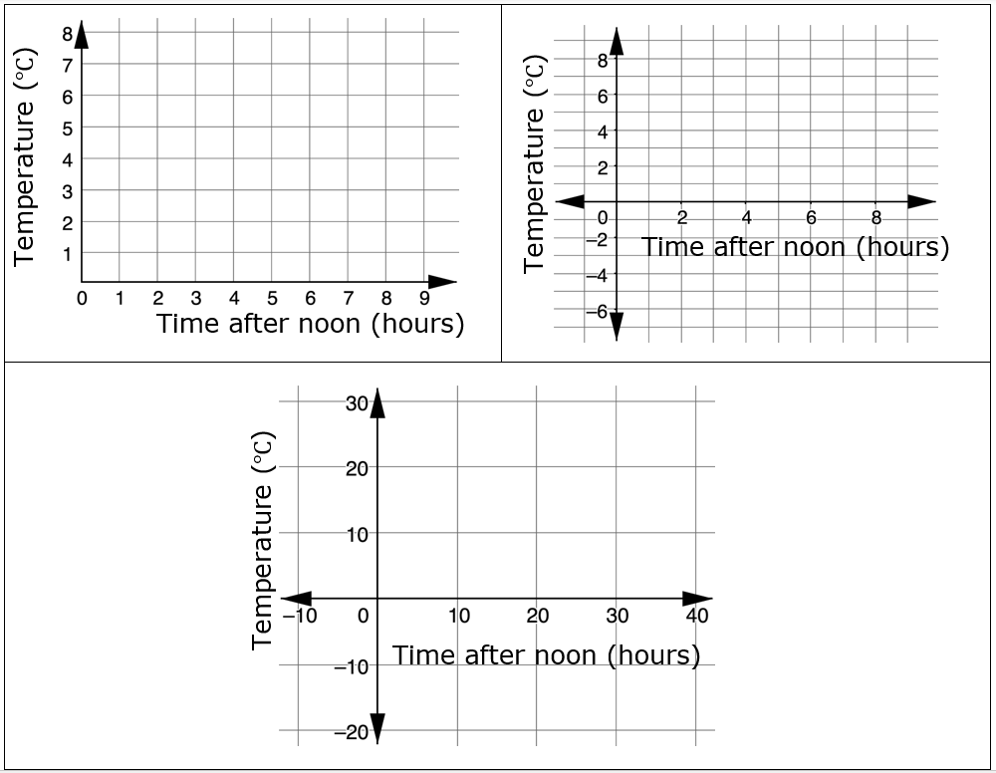
Three coordinate grids are shown, each using different scales.
volume 1, pg. 143

Slide 28
Explain which coordinate grid most accurately represents the data.
Explain why the other two coordinate grids may not be as accurate.
volume 1, pg. 143

Slide 29

Try It
volume 1, pg. 144

Slide 30

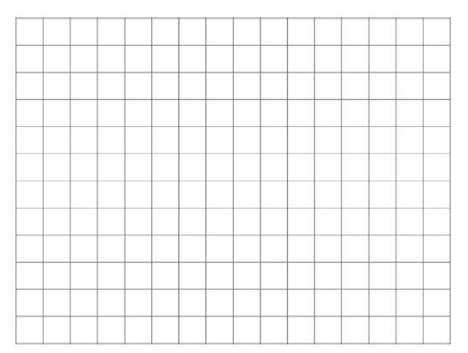
4.2.6 Try It: Plotting Points with Fractional and Decimal Scales
For the points $\left(1.75, −2.5\right)$ and $(−2.25, 1.5)$, draw and label coordinate axes with an appropriate scale, and plot the points.
volume 1, pg. 144

Slide 31
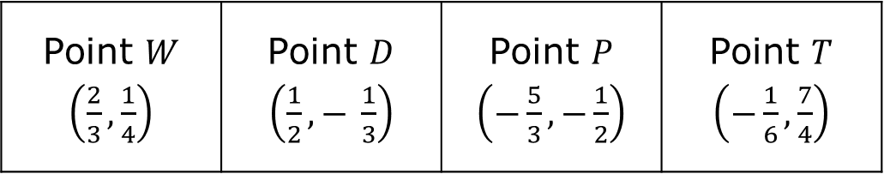
Draw and label coordinate axes with an appropriate scale. Then, plot and label the points.
Point $W$ $\left(\frac{2}{3}, \frac{1}{4}\right)$ | Point $D$ $\left(\frac{1}{2},− \frac{1}{3}\right)$ | Point $P$ $\left(−\frac{5}{3}, −\frac{1}{2}\right)$ | Point $T$ $\left(−\frac{1}{6}, \frac{7}{4}\right)$
volume 1, pg. 144

Slide 32

Wrap-Up
volume 1, pg. 145

Slide 33
4.2.7 Wrap-Up: Reflection
Shade the arrow up to the statement that best describes your current level of understanding.
 | I’m so confident, I could explain plotting ordered pairs made up of fractions and/or decimals to someone else!
 | I can get to the right answer, but I don’t understand it well enough to explain it yet.
 | I understand some of this, but I don’t understand all of it yet. I checked the boxes I think I do not understand.
 | I tried hard and I listened, but I am finding this challenging. I checked the boxes I think I do not understand.
volume 1, pg. 145

Slide 34
Check the skills that you currently understand.
Determining the correct scale
Identifying the LCM of the denominators for coordinates that include fractions
Plotting ordered pairs that contain fractions
Plotting ordered pairs that contain decimals
volume 1, pg. 145

